Slide 1

Git Integration with Jenkins
Streamlining Your CI/CD Pipeline with Powerful Version Control

Slide 2
Agenda
1
Role of Git in Jenkins Pipelines
Understanding the fundamental relationship
2
Installation & Configuration
Setting up Git on your Jenkins server
3
Jenkins + Git Workflow
From code commit to deployment
4
Practical Implementation
Freestyle jobs and webhook integration
5
Live Demonstration
Seeing the integration in action

Slide 3

The Role of Git in Jenkins Pipelines
Git serves as the foundation of modern CI/CD pipelines within Jenkins by:
Providing version control for application source code
Enabling collaborative development across teams
Triggering automated builds when code changes are detected
Maintaining a historical record of all code changes
Supporting branching strategies for feature development, testing, and production

Slide 4

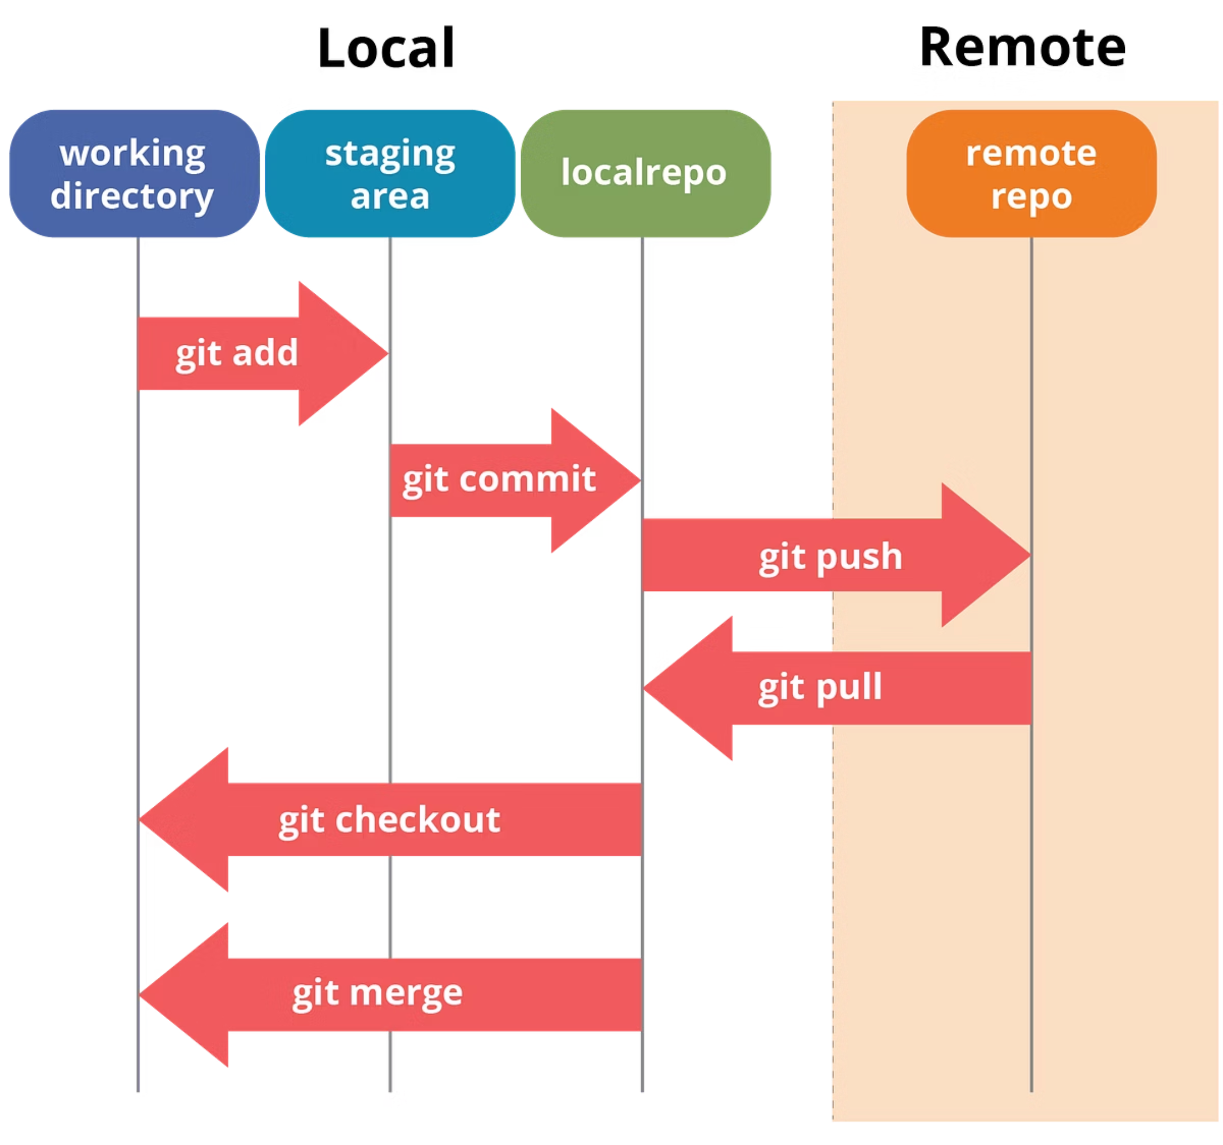
Installing Git on Jenkins Server
Verify Java Installation
Ensure Jenkins is properly installed with compatible Java version
Install Git
For Linux: sudo apt-get install git or sudo yum install git
For Windows: Download and install Git from git-scm.com
Verify Installation
Run git --version to confirm successful installation
The Jenkins user must have appropriate permissions to execute Git commands. For Windows servers, ensure Git is added to the system PATH.

Slide 5
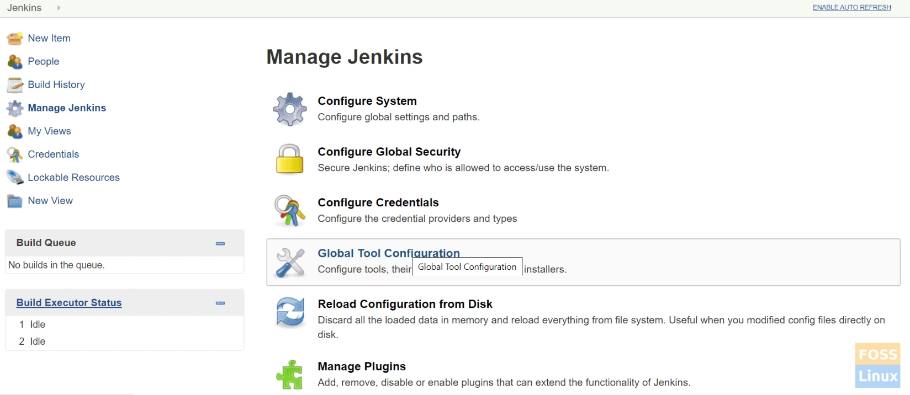
Configuring Git in Jenkins
Global Tool Configuration
Navigate to Jenkins Dashboard
Go to "Manage Jenkins" → "Global Tool Configuration"
Scroll to Git section
Click "Add Git"
Provide a name (e.g., "Default Git")
Specify path to Git executable
Click "Save"
The Global Tool Configuration allows Jenkins to locate and use the Git executable for all jobs requiring Git integration.

Slide 6




Jenkins + Git Workflow
Clone
Build
Jenkins clones the Git repository to workspace
Source code is compiled or packaged
Test
Deploy
Automated tests verify code quality
Application is deployed to target environment
This workflow creates a continuous integration and delivery pipeline that automatically processes code changes from commit to deployment, ensuring consistent and reliable software releases.

Slide 7
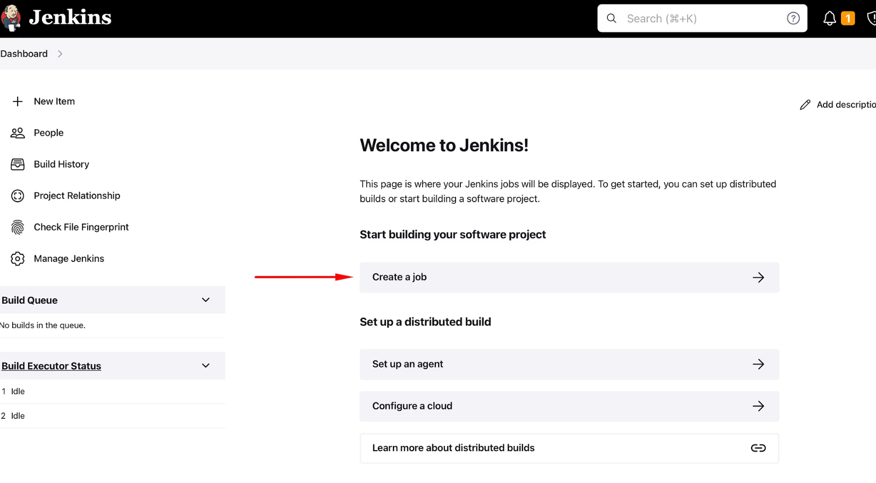
Creating a Jenkins Freestyle Job with Git
From Jenkins dashboard, click "New Item"
Enter job name and select "Freestyle project"
In Source Code Management section, select "Git"
Enter repository URL (HTTPS or SSH)
Specify branch to build (e.g., */main, */master)
Configure build triggers (e.g., poll SCM)
Add build steps (e.g., Execute shell/batch command)
Save the configuration
Freestyle projects offer flexibility for simple integration scenarios and are an excellent starting point for Git integration with Jenkins.

Slide 8
Advanced Git Configuration in Jenkins
Credentials Management
Branch Specifiers
Store Git credentials securely using Jenkins Credentials Plugin for accessing private repositories
Configure specific branches or patterns (e.g., */feature/* for all feature branches)
Submodules
Shallow Clone
Enable "Advanced" options to recursively clone Git submodules
Optimize performance by limiting history depth for large repositories
These advanced configurations help tailor Git integration to your specific project requirements and optimize build performance.

Slide 9
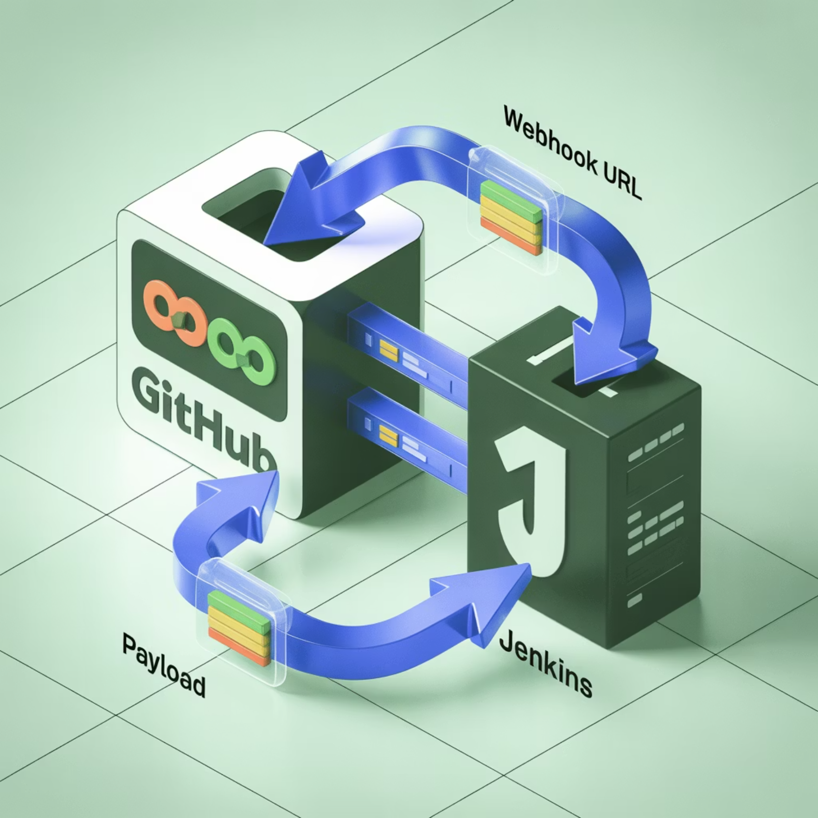
Webhook Integration with Git Providers
Setting Up Webhooks
Webhooks enable automatic triggering of Jenkins jobs when code changes are pushed to your Git repository.
Supported Git Providers:
GitHub
GitLab
Bitbucket

Slide 10
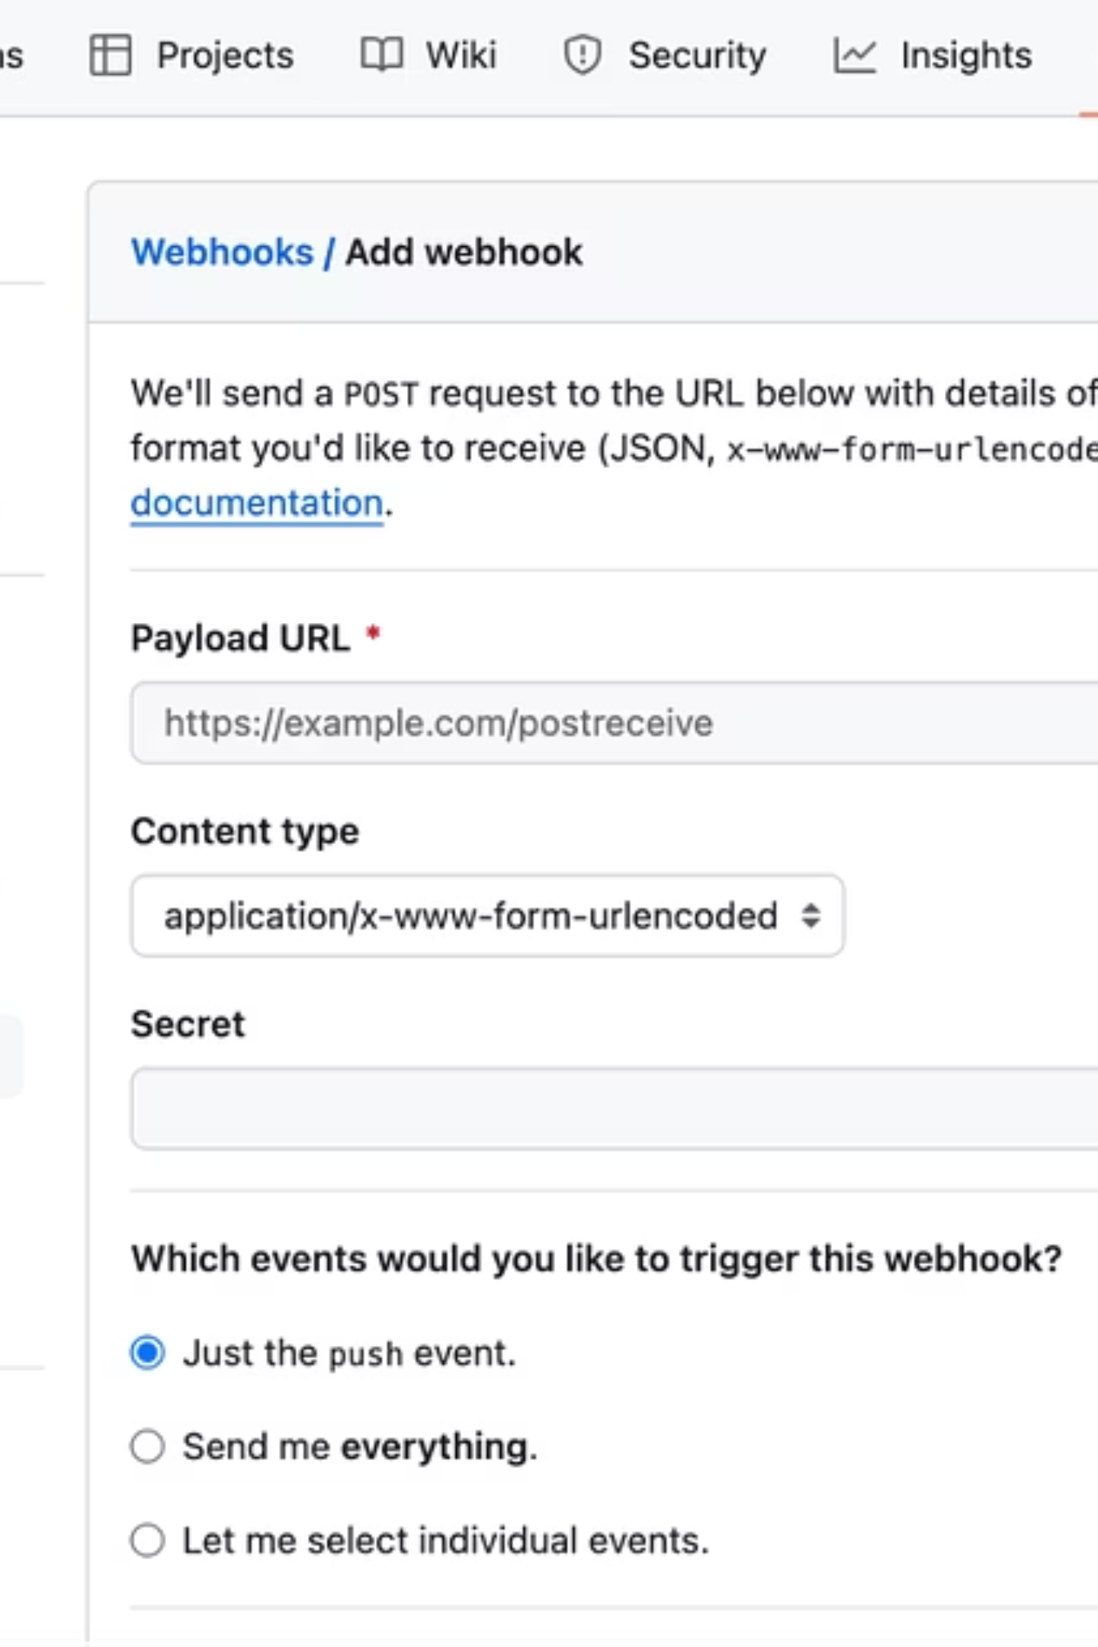
GitHub Webhook Configuration
Jenkins Setup
Install GitHub Integration plugin in Jenkins
Configure job to use "GitHub hook trigger for GITScm polling"
GitHub Setup
Go to repository Settings → Webhooks → Add webhook
Set Payload URL to: http://your-jenkins-url/github-webhook/
Select "application/json" content type
Test Connection
Click "Test" button in GitHub webhook settings
Verify Jenkins receives the webhook in system logs

Slide 11
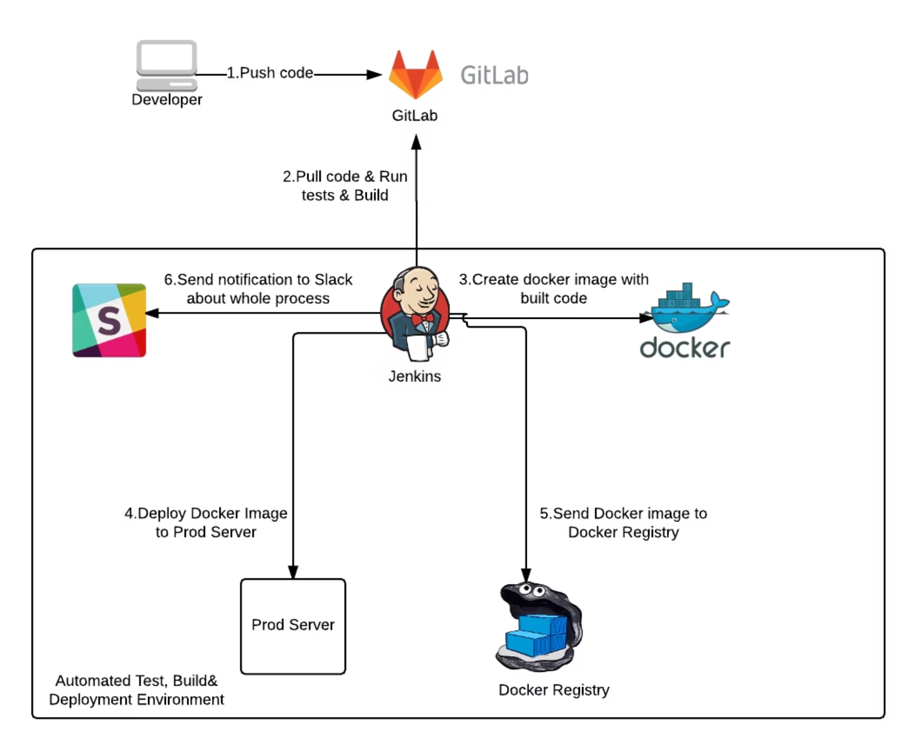
Demo: Git Push to Jenkins Build
Workflow Demonstration
Developer commits code and pushes to Git repository
Git provider sends webhook notification to Jenkins
Jenkins job is automatically triggered
Build process executes (compile, test, package)
Build results are reported back to Git provider
This automated workflow eliminates manual build initiation, accelerating the development cycle and providing immediate feedback on code changes.

Slide 12
Key Takeaways
Seamless Integration
Simple Setup
Git and Jenkins form a powerful combination for modern CI/CD pipelines, automating the software delivery process.
Installing and configuring Git with Jenkins requires minimal effort but delivers significant workflow improvements.
Automated Workflows
Next Steps
Webhooks eliminate manual intervention, creating a truly automated pipeline from code commit to deployment.
Explore Jenkins Pipeline as Code with Jenkinsfile stored in your Git repository for even more powerful integration.
Questions? Contact: devops@example.com

